Slide 1

Applications of partial Fractions
Group 1
Roll nos: C034,C044,C049,C056

Slide 2
Introduction to Partial fraction method
An algebraic fraction can be broken down into simpler parts known as “partial fractions“. Consider an algebraic fraction, (3x+5)/(2x²-5x-3). This expression can be split into simple form like (2)/(x-3) – (1)/(2x+1).
It is basically "decomposing" the final expression into its initial polynomial fractions.
Thus, algebraic expression can be written in the form of: (3x+5)/(2x²-5x-3) = ((2)/(x-3))-((1)/(2x+1))
The procedure for finding the partial fraction is:
While decomposing the rational expression into the partial fraction, begin with the proper rational expression.
Now, factor the denominator of the rational expression into the linear factor or in the form of irreducible quadratic factors (Note: Don’t factor the denominators into the complex numbers).
Write down the partial fraction for each factor obtained, with the variables in the numerators, say A and B.
To find the variable values of A and B, multiply the whole equation by the denominator. Solve for the variables by substituting zero in the factor variable.
Finally, substitute the values of A and B in the partial fractions

Slide 3
Lets look at an example to understand why partial fraction is used in integration :
Q: Integrate the function 1(x−3)(x+1) with respect to x.
The given integrand can be expressed in the form of partial fraction as:
1/(x−3)(x+1)=A/x−3)+B/(x+1)
To determine the value of real coefficients A and B, the above equation is rewritten as:
1= A(x+1)+B(x-3)
⇒1=x(A+B)+A-3B
Now, equating the coefficients of x and the constant, we have
A + B = 0
A – 3B = 1
Solving the equations with the value of A =1/4 and B = -1/4. Substituting these values in the equation 1;
1/ (x−3)(x+1)=1/ 4(x−3)+−1/ 4(x+1)
Integrating with respect to x ;
∫1/ (x−3)(x+1)=∫1/ 4(x−3)+∫−1/ 4(x+1)
According to the properties of integration, the integral of sum of two functions is equal to the sum of integrals of the given functions, i.e.:
∫[f(x) +g(x)]dx = ∫f(x)dx + ∫g(x)dx
Therefore,
=1/4 ∫1(x−3)–1/4 ∫1(x+1)
=1/4 ln|x−3|–1/4 ln|x+1|
=1/4 ln∣∣x−3x+1∣∣

Slide 4
Applications of Partial Fractions
Many logistic differential equations are required when analyzing population growth including integration technique when solving such a differential equation via integration by parts.
Used for solving the differential equation for a person falling through the sky with an air resistance proportional to person’s velocity squared.
In rational numbers: We can define a rational function as the ratio of two polynomial functions P(x) and Q(x), where P and Q are polynomials in x and Q(x)≠0. A rational function is known as proper if the degree of P(x) is less than the degree of Q(x); otherwise, it is known as an improper rational function. With the help of the long division process, we can reduce improper rational functions to proper rational functions. Therefore, if P(x)/Q(x) is improper, then it can be expressed as:
P(x)/Q(x)=A(x)+R(x)/Q(x)
Here, A(x) is a polynomial in x & R(x)/Q(x) is a proper rational function.
In order to integrate a rational function, it is reduced to a proper rational function. After splitting the integrand into partial fractions, it is integrated accordingly with the help of traditional integrating techniques.

Slide 5
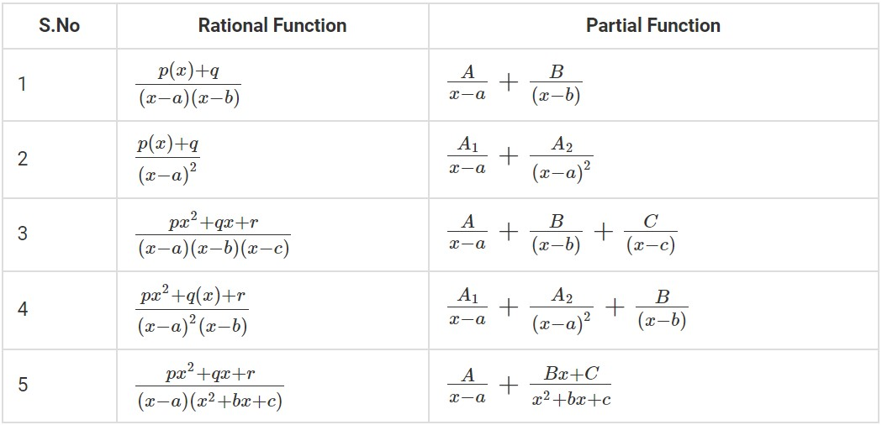
Here the list of Partial fractions formulas is given.

Slide 6
In improper fractions: Suppose, m is the degree of the denominator and n is the degree of the numerator. Then, in addition to the partial fractions arising from factors in the denominator, we must include an additional term: this additional term is a polynomial of degree n − m.
Note:
A polynomial with zero degree is K, where K is a constant
A polynomial of degree 1 is Px + Q
A polynomial of degree 2 is Px²+Qx+K
Two applications that we will discuss in detail are:
System Modelling
Mercator map projection

Slide 7

System Modelling

Slide 8
System Modelling:
The process of developing abstract models of a system, with each model presenting a different view or perspective of that system.
It is a mean of representation a world-wide view of the system using the same type of graphical notations.
In engineering, it is an approach to software developments.
What’s the connection?
• Inverse of Laplace transformation is used to simplify calculations in system modelling.
• In order to find the inverse of Laplace transformation, partial fraction method is used

Slide 9
Advantages
Disadvantages
Allows systems to be considered at higher level of abstraction.
Generates codes automatically
Helps in viewing the system from multiple perspectives.
Discover causes and effects using model traceability.
The cost of developing the translator for the platform is high.
Application:
Useful for companies to communicate with the customers.
Extremely useful in other field such as: Architecture, statistics, planning, etc.

Slide 10
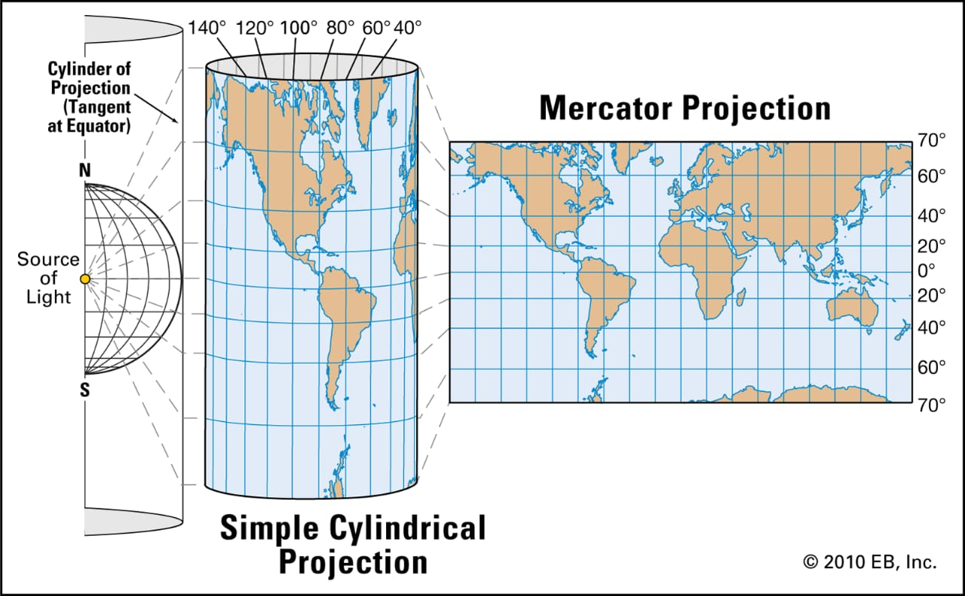
Mercator Map Projection

Slide 11
Mercator Projection:
The Mercator projection is a cylindrical map projection.
It became the standard map projection for navigation because it is unique in representing north as up and south as down everywhere while preserving local directions and shapes.
The map is thereby conformal.
What’s the connection?
Partial fractions decomposition is a necessary step in the integration of the secant function.
Integration of the secant function is necessary to draw a Mercator map projection.

Slide 12
Advantages
Disadvantages
It is easier to plot courses on a Mercator projection.
This method ensures that angles and shapes stay true.
Distortions don’t occur when zooming in with a large map.
All cylindrical projections, meridians, and parallels are straight and perpendicular to one another.
It provides tangible information.
It forces the map to create a distortion away from the equator.
Its usefulness is limited in the polar regions of the planet.
You cannot compare the area of landmasses with a Mercator projection.
Application:
The Mercator projection was widely used in navigation, and is the one used in Google Maps and most other navigation software today.
Mercator projections were also important in the mathematical development of plate tectonics in the 1960s.

Slide 13


Slide 14
Partial Fraction Method can be considered as one of the building blocks in mathematics.
It is a very important concept as it forms the basics of many fields which include various types of engineering, Architecture, Finance and many more.
So, as we have seen in the example of system modelling which is used in software engineering, I could say that if we understand this concept perfectly, then it will be of great use to us in our future.
- Amishi

Slide 15
This method is used to decompose a given rational expression into simpler fractions.
In other words, if I am given a single complicated fraction, my goal is to break it down into a series of “smaller” components or parts.
The importance of the partial fraction decomposition lies in the fact that it provides algorithms for various computations with rational functions
- Aneri

Slide 16
Partial fractions method makes understanding and solving complex Integration numerical faster and easier.
For example in the Mercator projection using the integration of the secant function it may have been the first integration problem for which partial fractions were used.
- Chahel

Slide 17
The real life applications of partial fractions have been affecting my day to day life without even knowing it , from google maps that is almost used by everyone Partial Fraction also apply to all the sciences (physics, biology and chemistry).
In conclusion, I learned that Partial Fraction is crucial to so many activities that we perform daily.
- Reneeka

Slide 18
